Slide 1

Airbnb performance Dashboard

Slide 2
Social Media Slide
Make a big impact with our professional slides and charts
Data Preparation Using Tableau Prep Builder 2021.1
A
Data Cleansing
Dashboard Representation
B
Dashboard Overview
Display hosting Detail, Price, Type for top 10 hosting
C
Hosting Dashboard
Indicators
D
Indicators

Slide 3
Data Preparation
Tableau Prep Builder
Import Data source (Listing, Review and Calendar
EDA
To Explore Data insight is very easy
Data Cleansed
After Load, Extract and Transform data. We can export data into CSV file

Slide 4
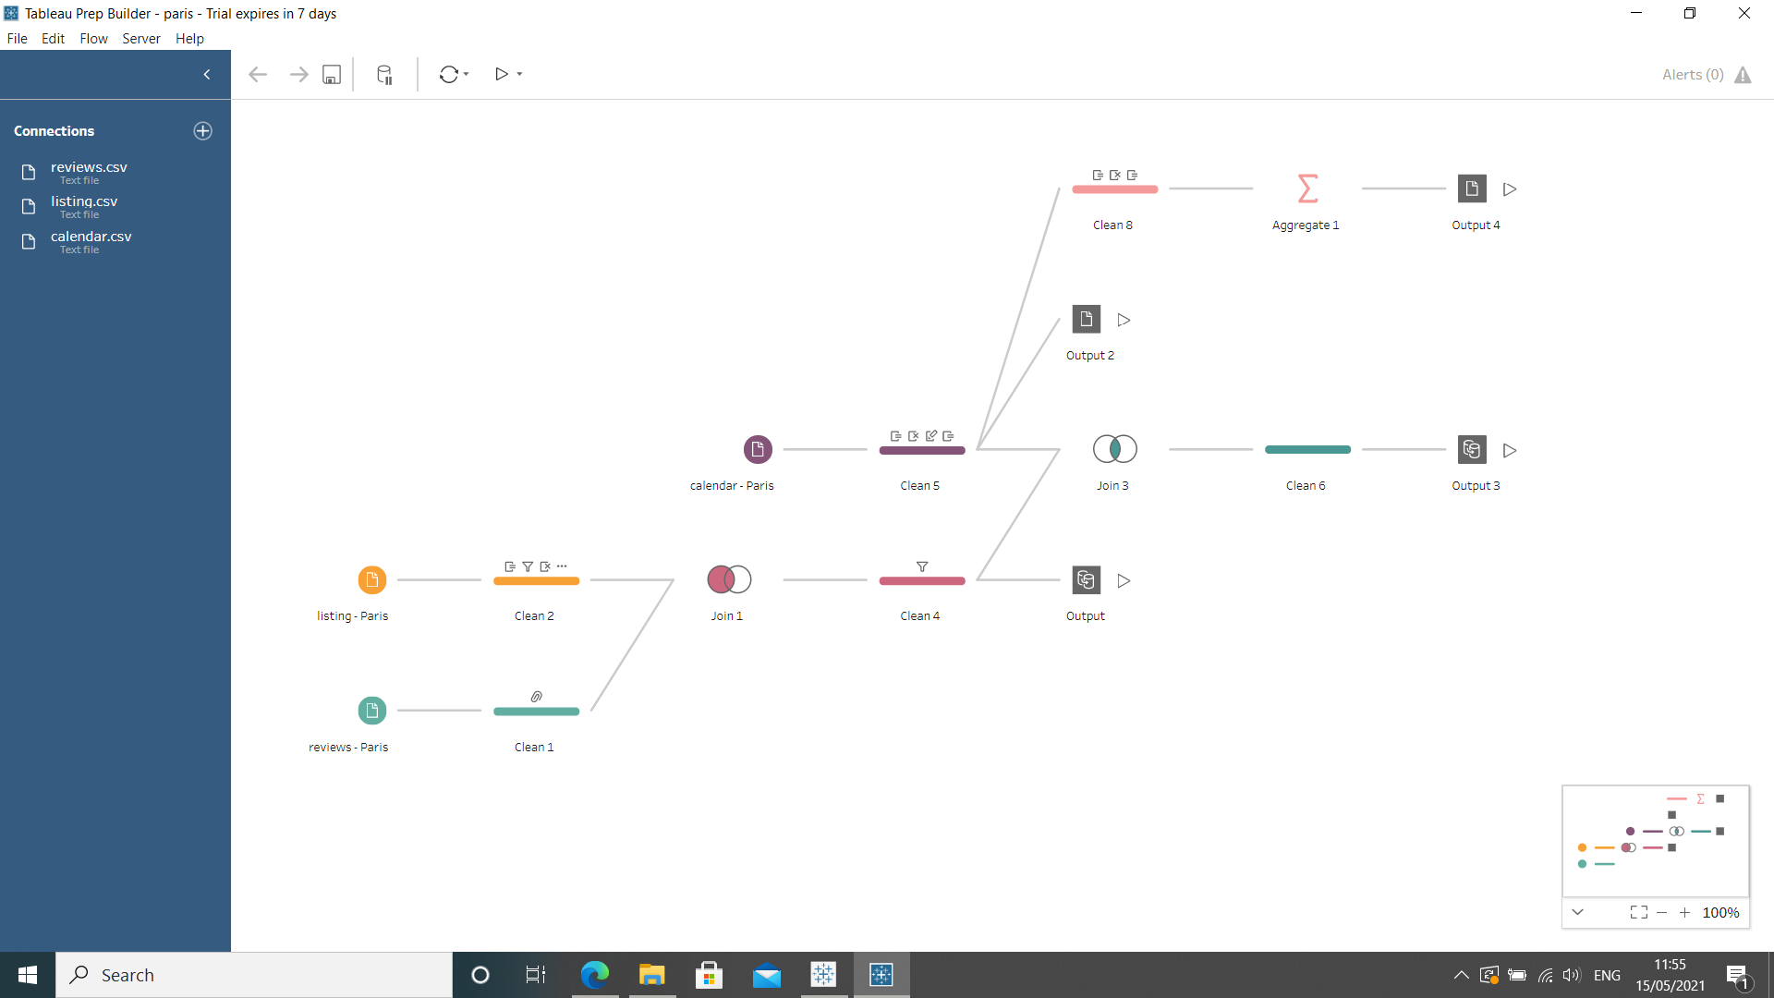
Tableau Prep Builder

Slide 5
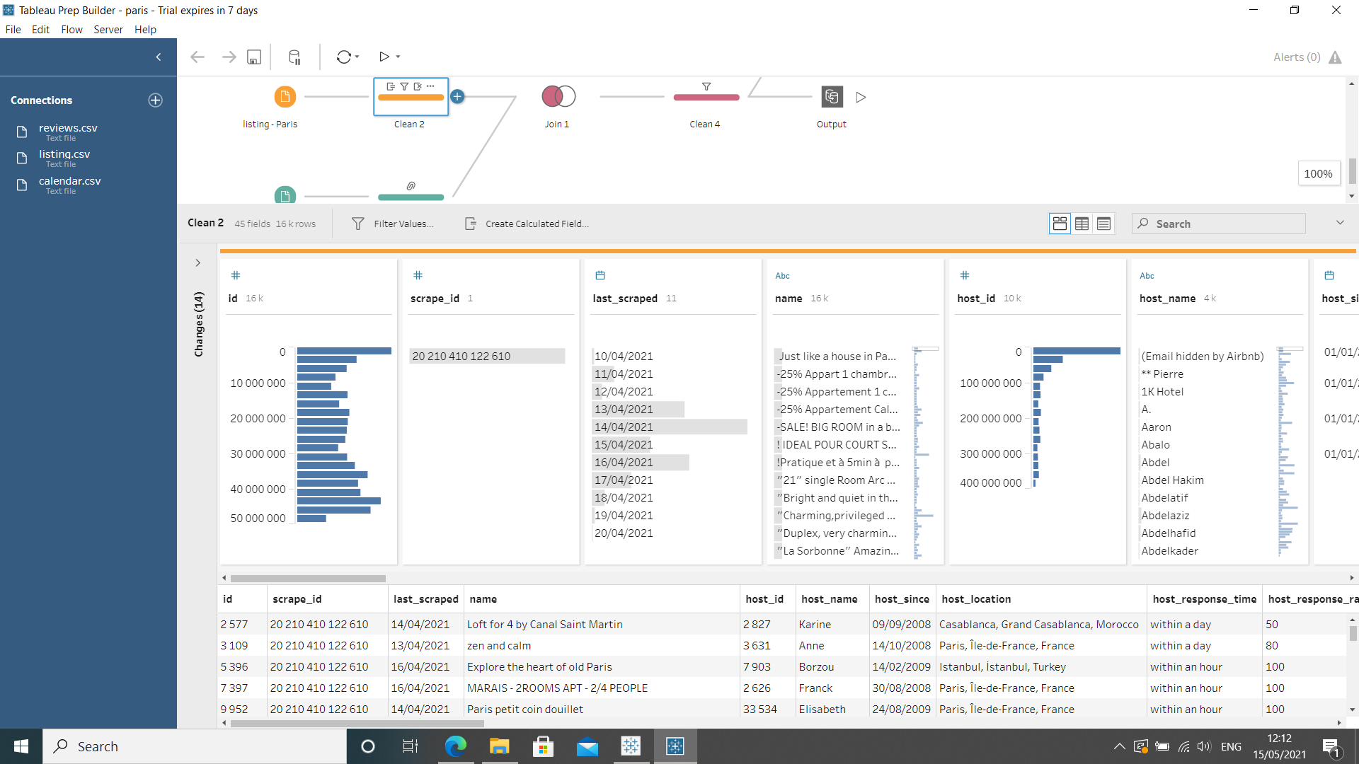
Exploratory Daa

Slide 6
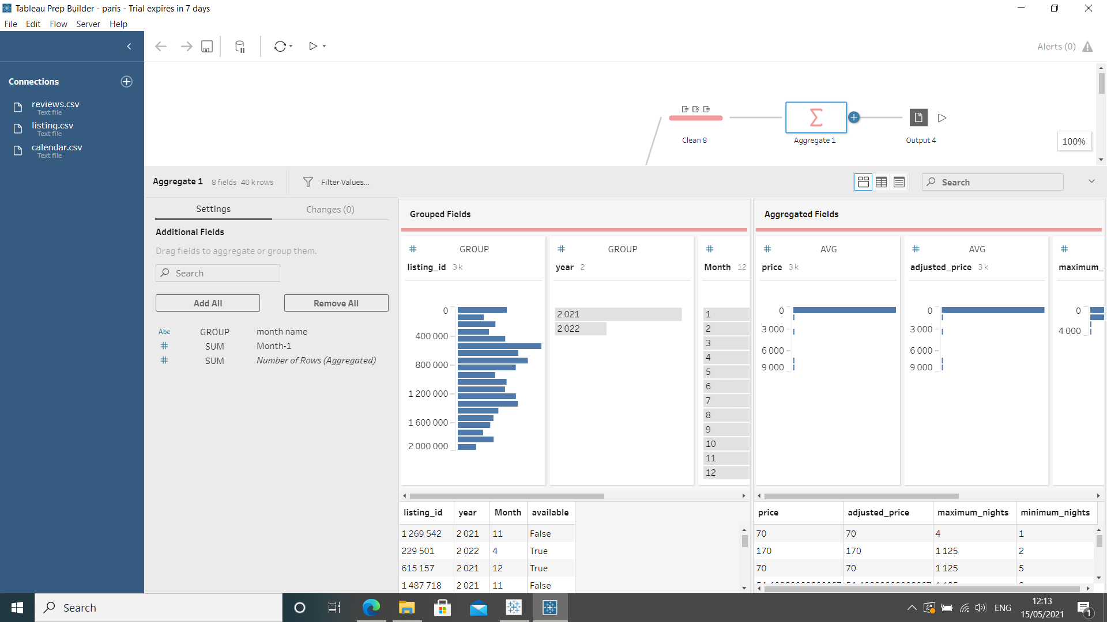
Aggregation

Slide 7
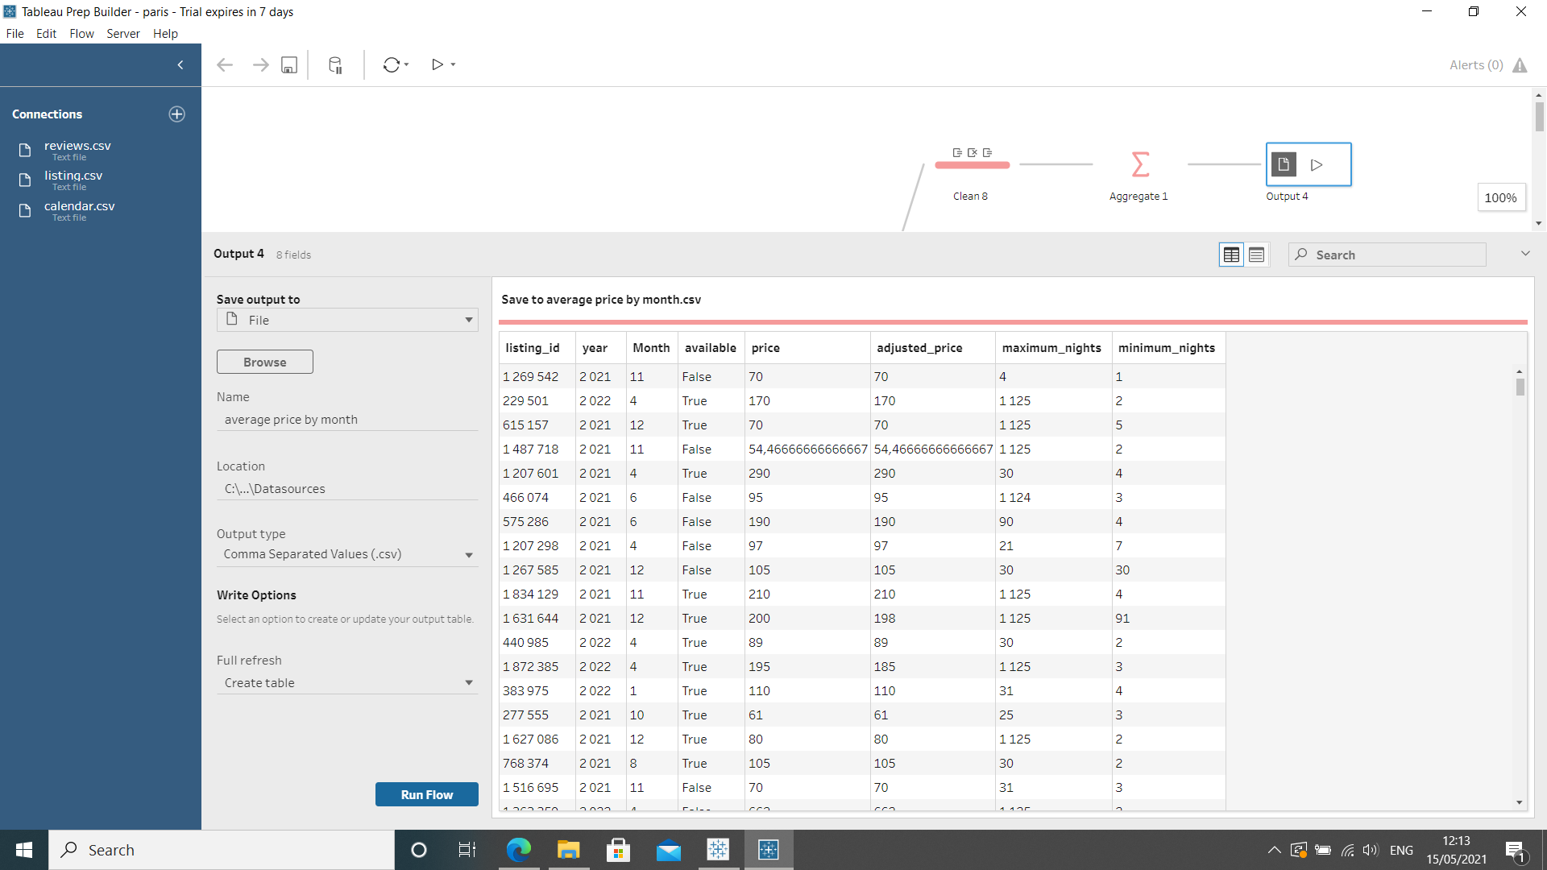
Exporting Data

Slide 8
Dashboards
AirBnB Performance Dashboard
To summarize the main information on AirBnB - Paris
Bottom 10 Reviews
Gathering all low score review
Hosting Details
Display Detail in each hotings

Slide 9
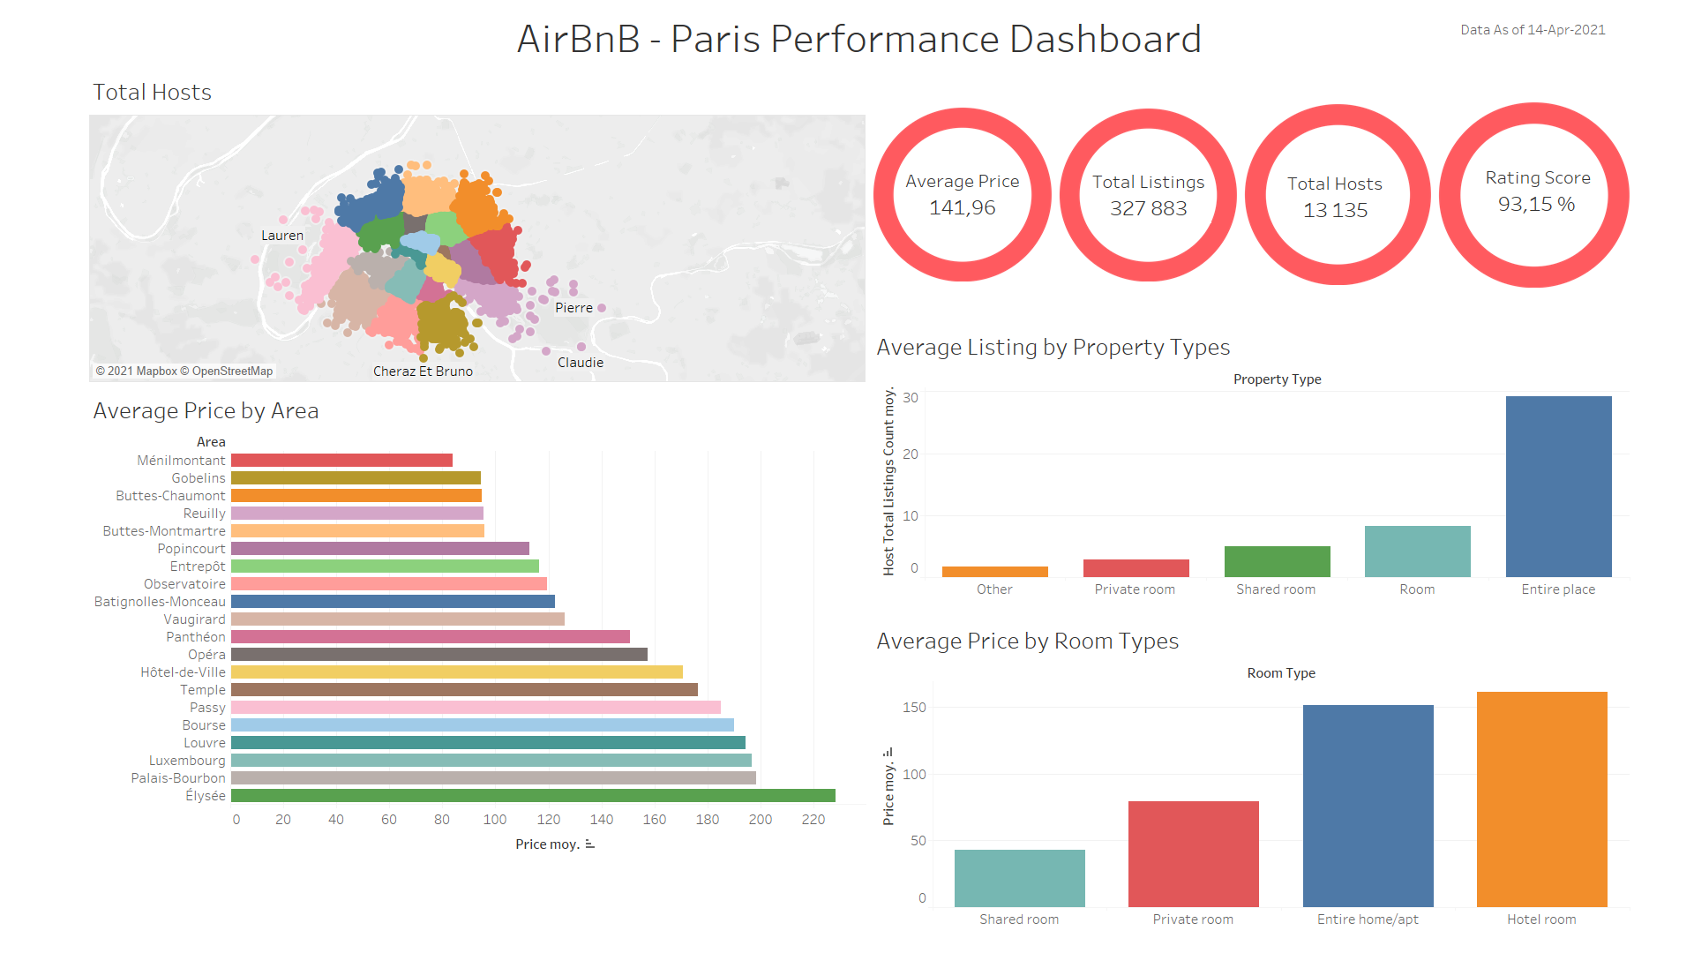

Slide 10
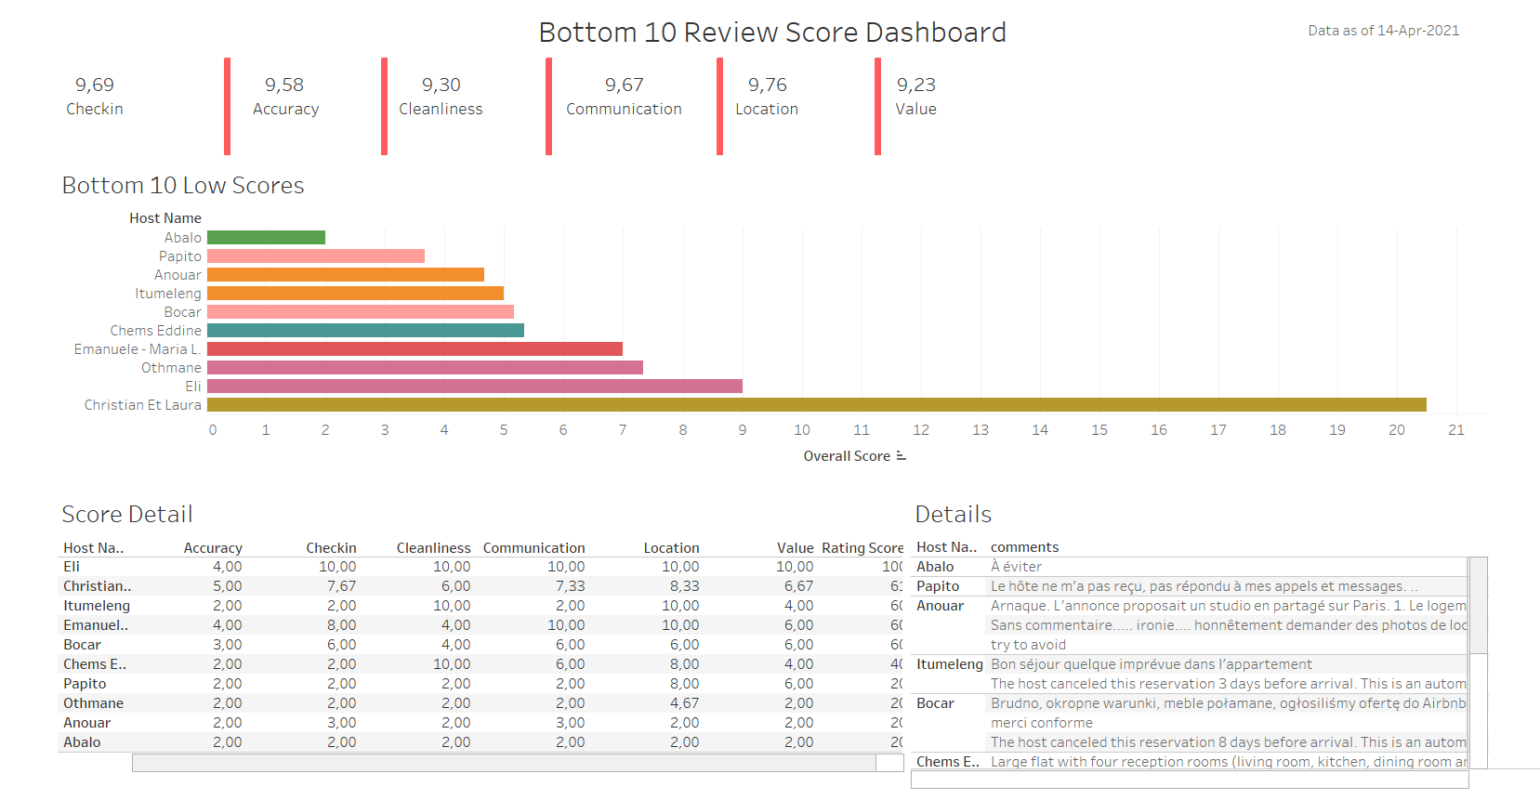

Slide 11
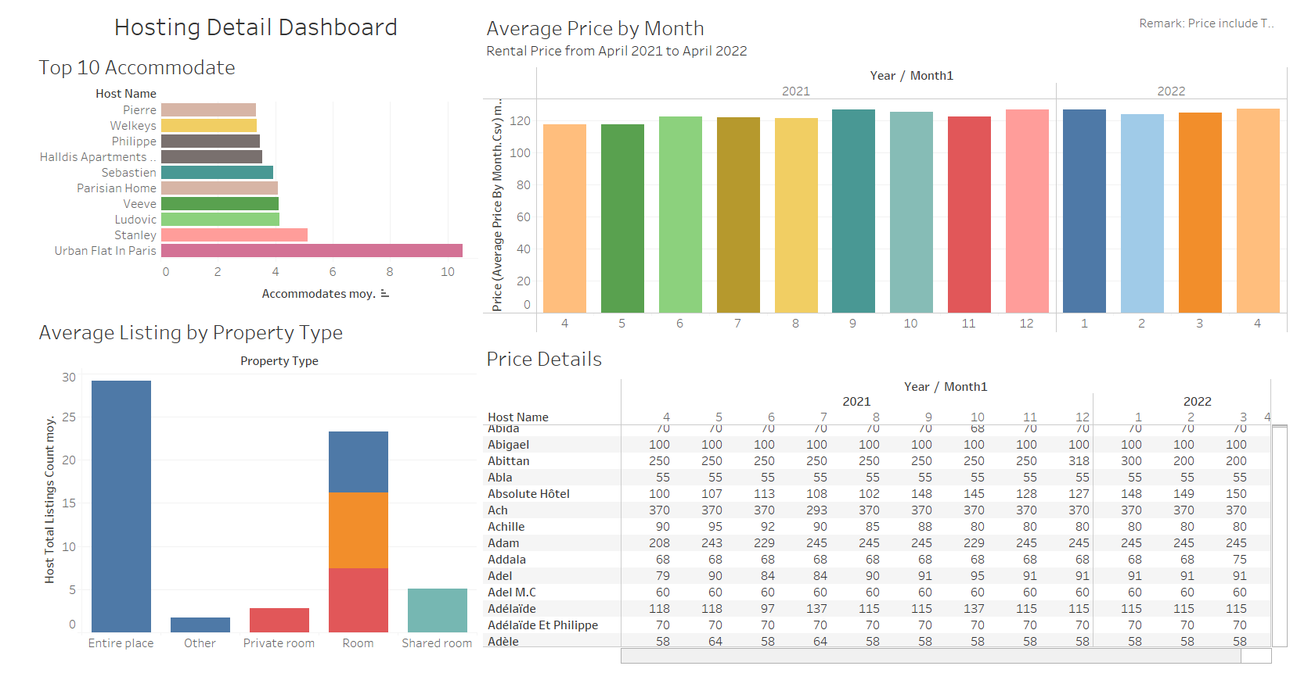

Slide 12
All Indicators
All indicators that have shown on Dashboards
After we transformed dataset on Tableau Prep Builder. We imported all attributes (Dimensions and Measures) to Tableau to represent the dashboards

Slide 13
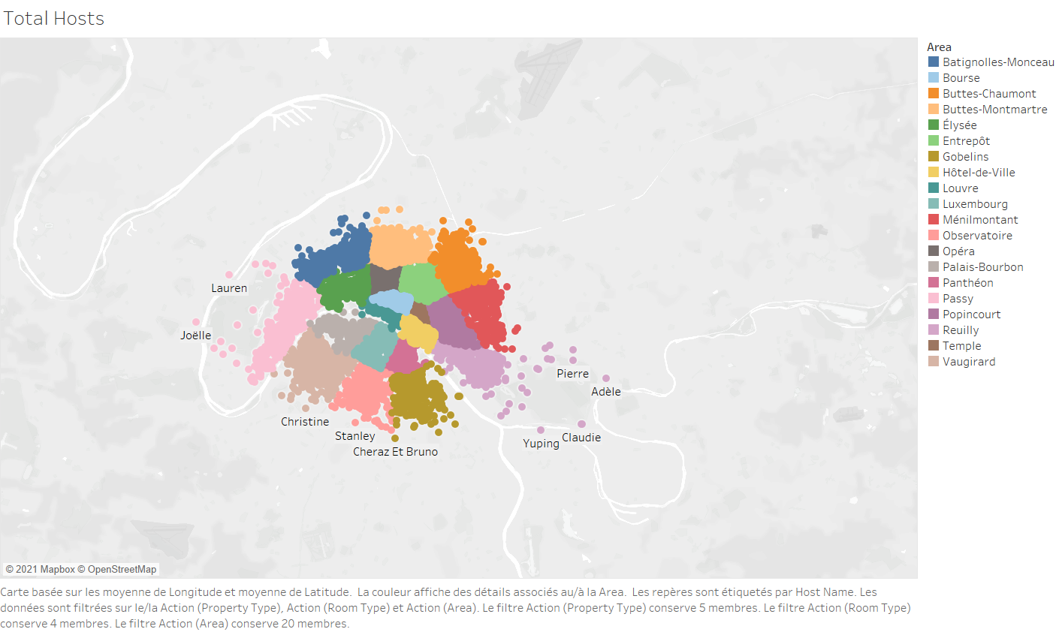

Slide 14
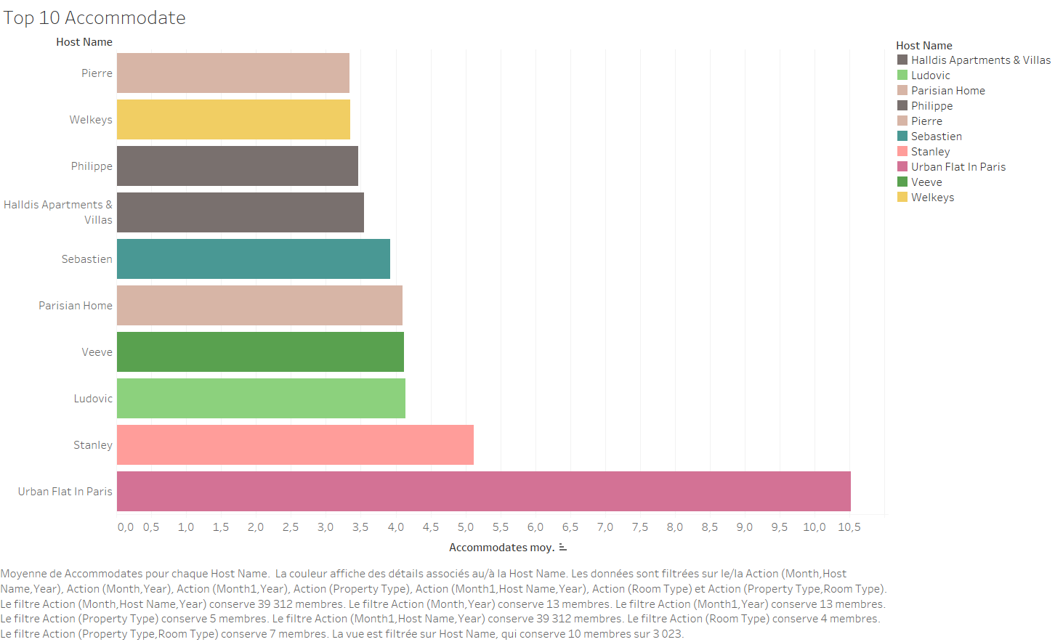

Slide 15
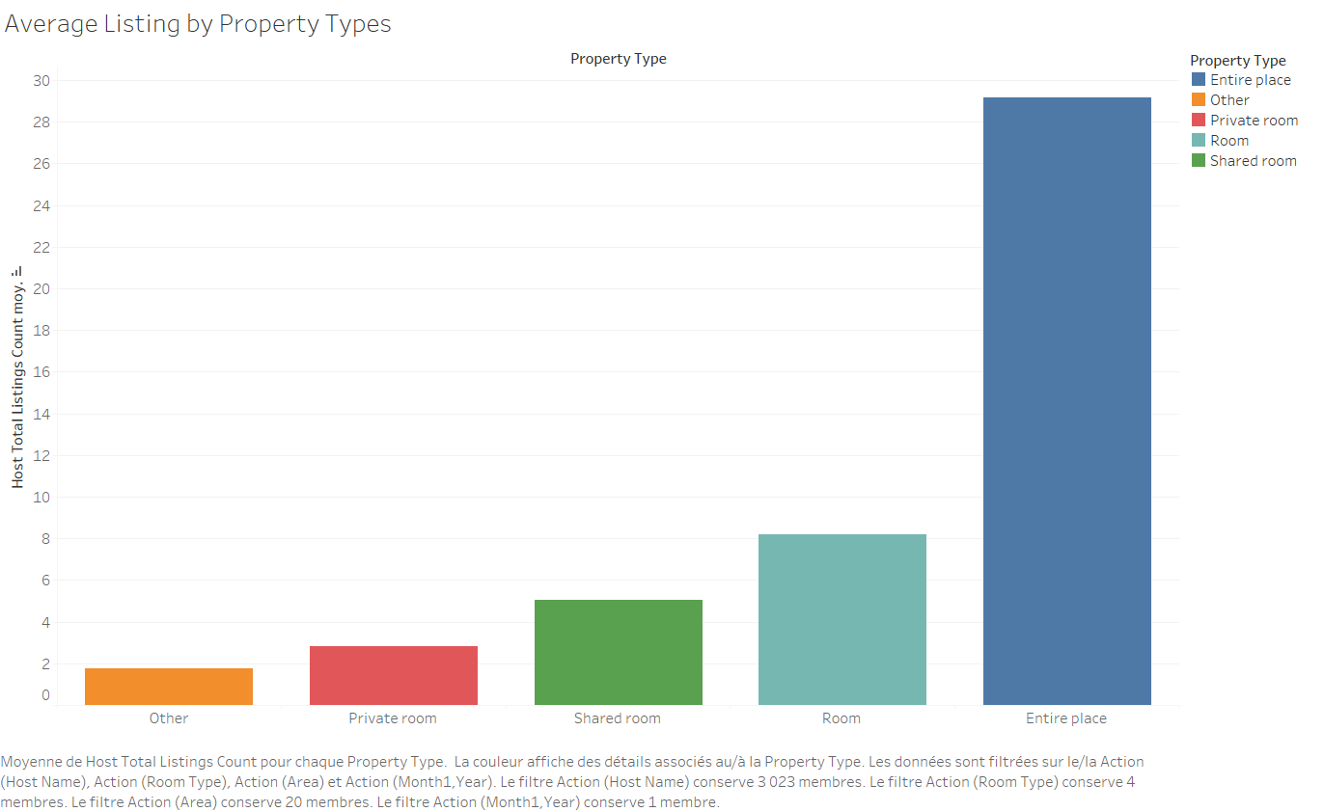

Slide 16
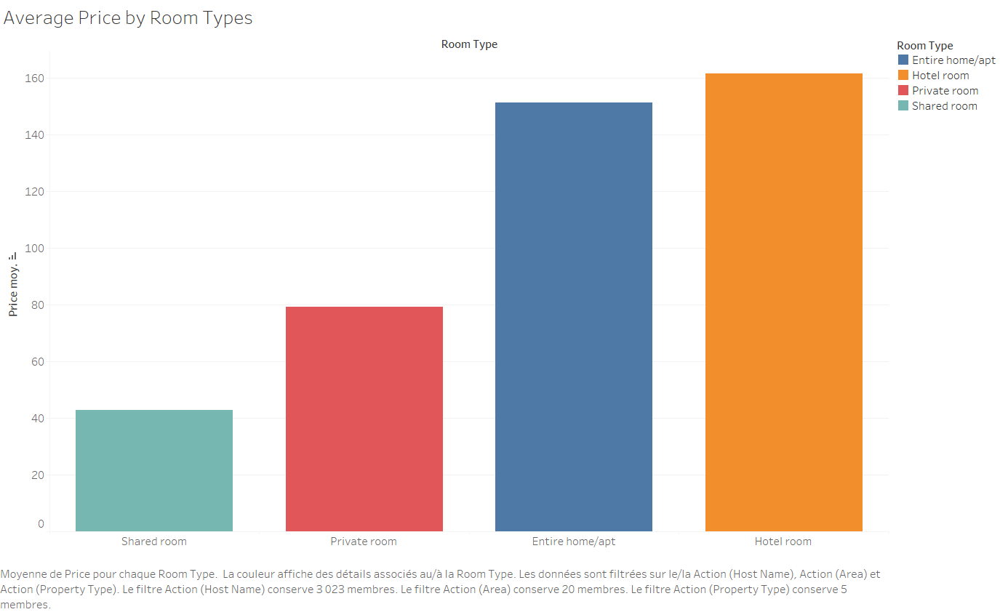

Slide 17
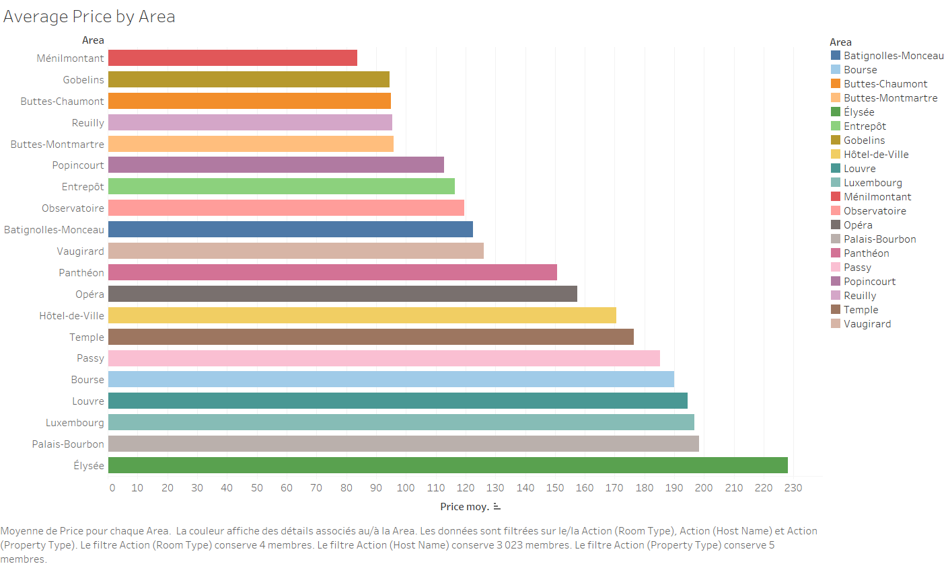

Slide 18
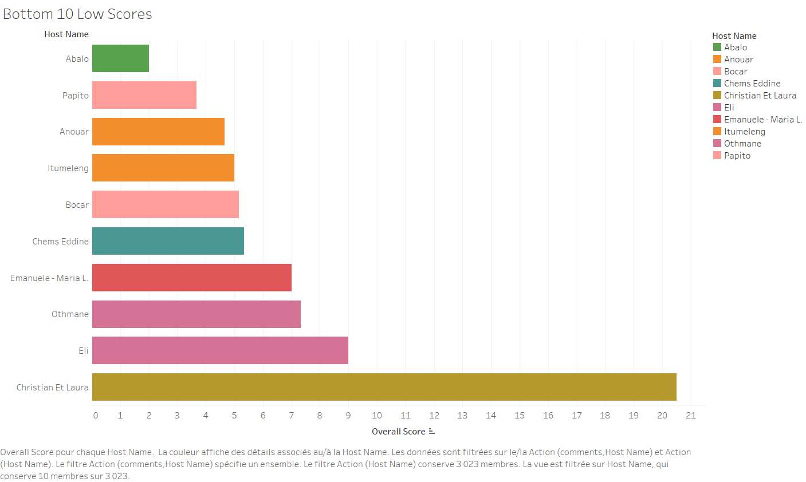

Slide 19
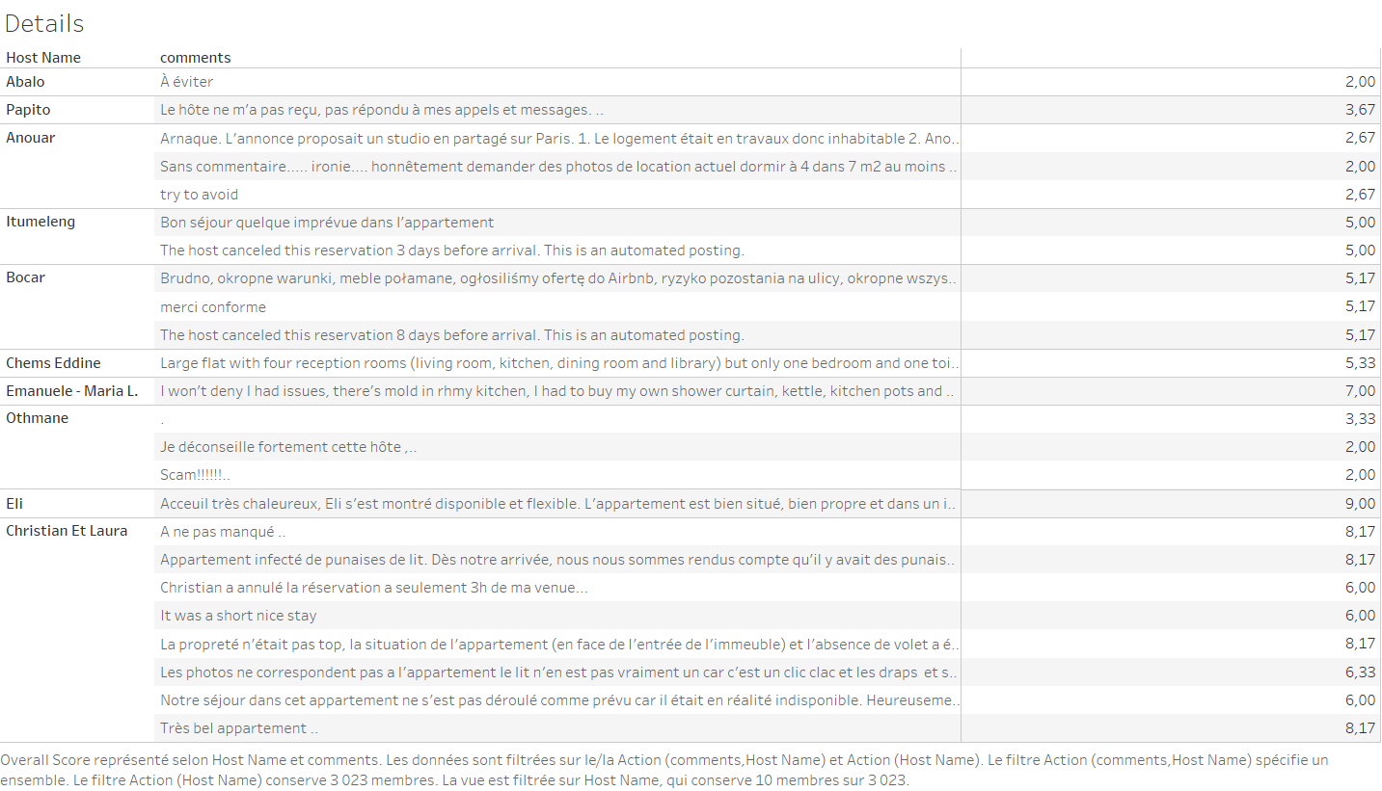

Slide 20
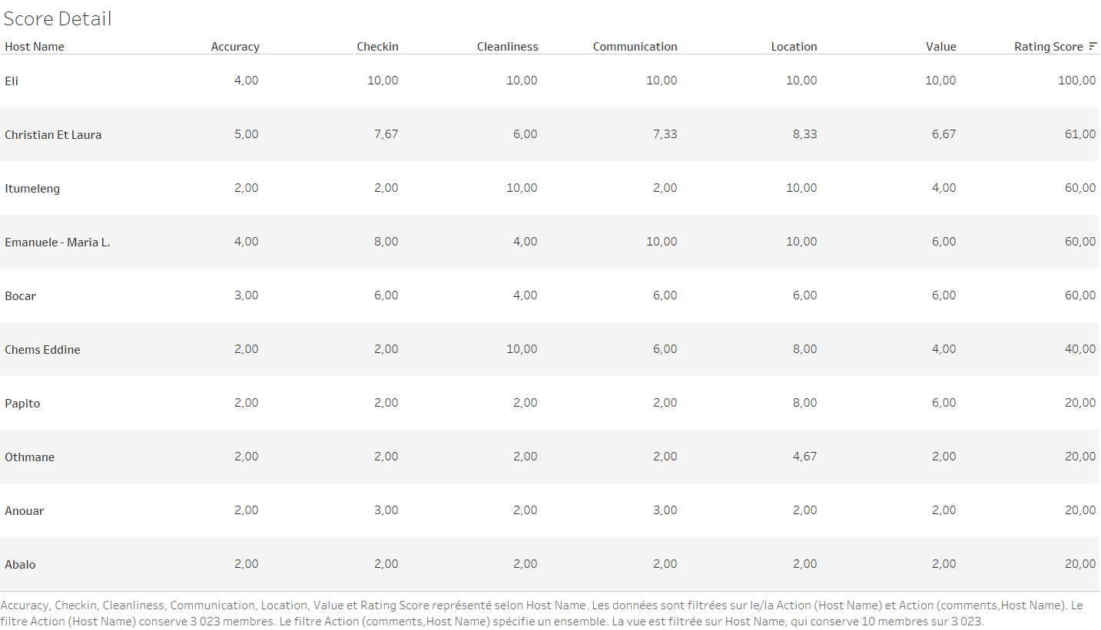

Slide 21
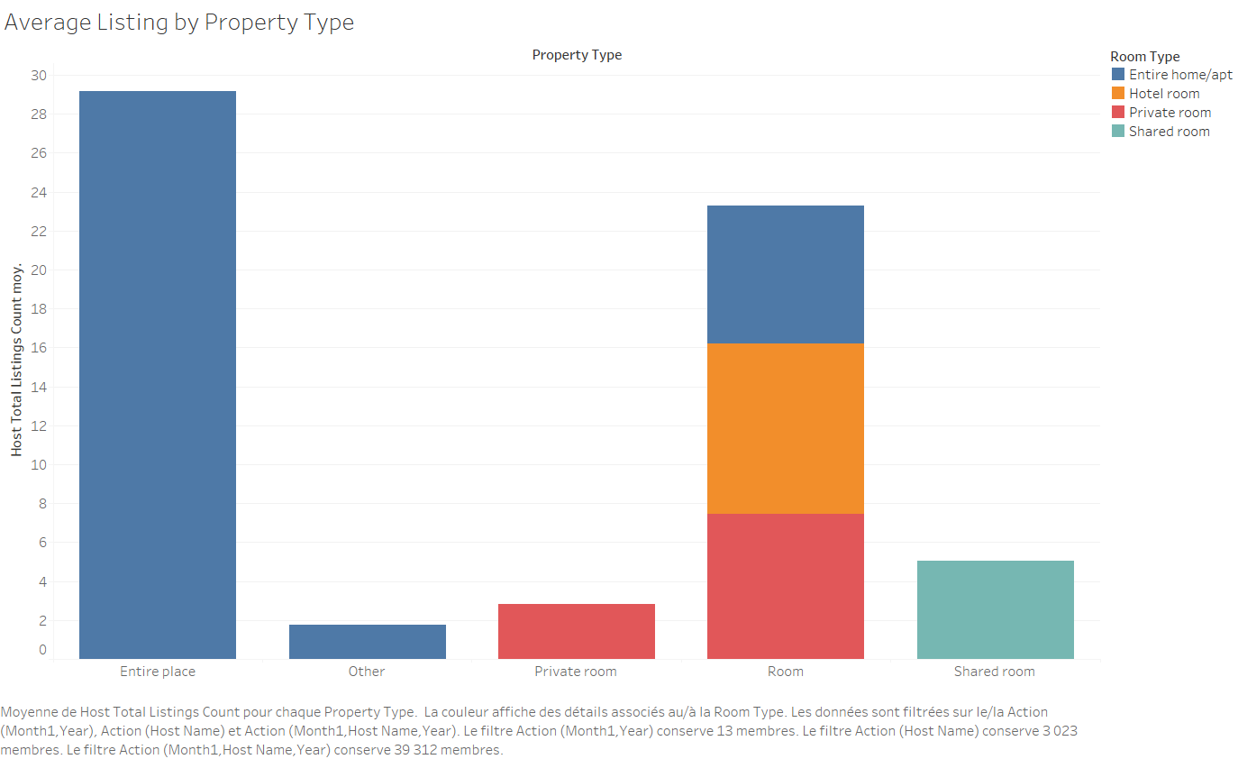

Slide 22
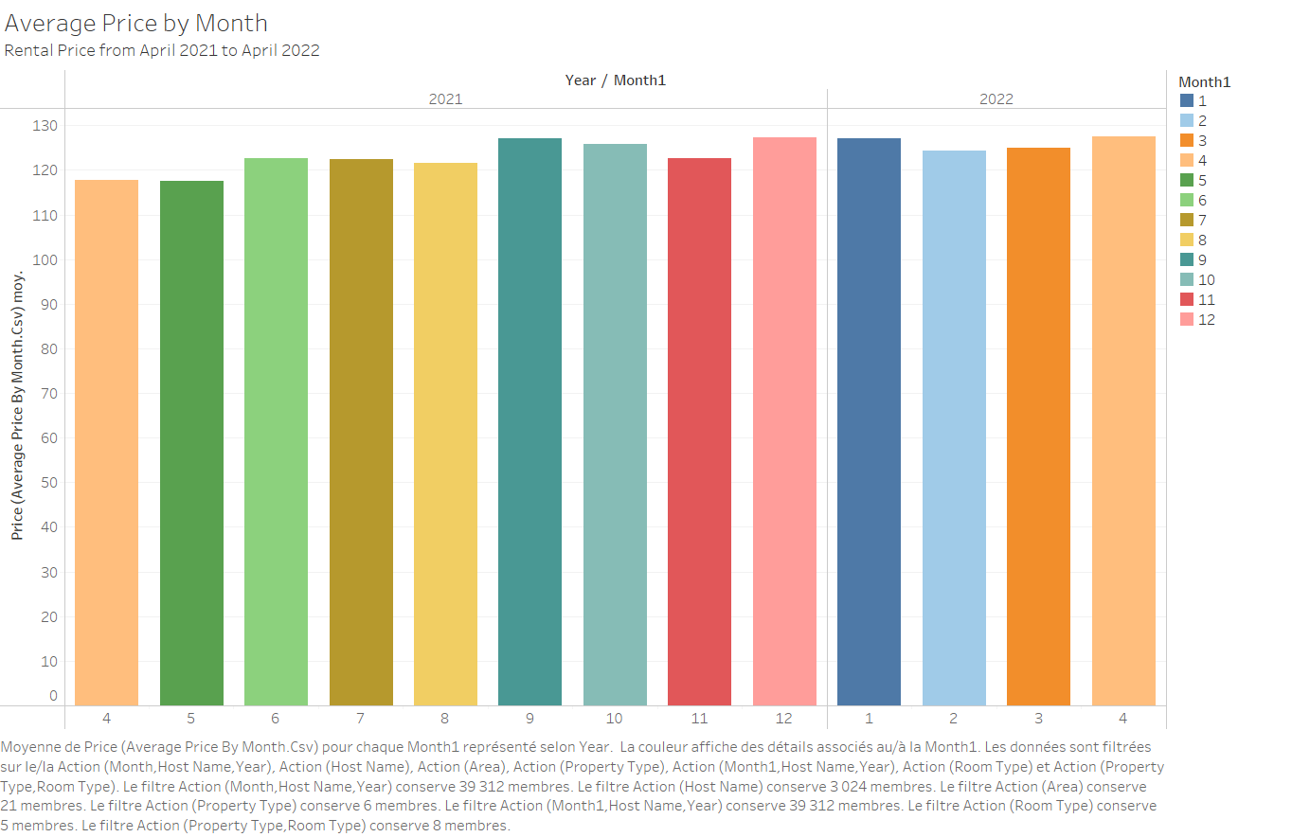

Slide 23
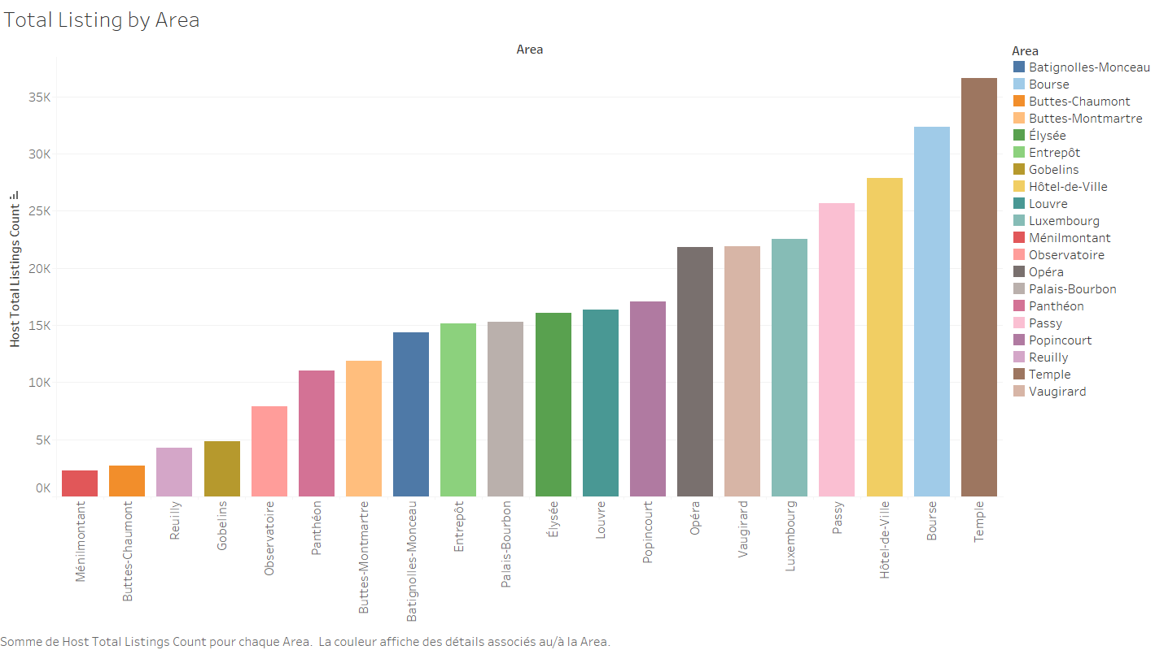

Slide 24
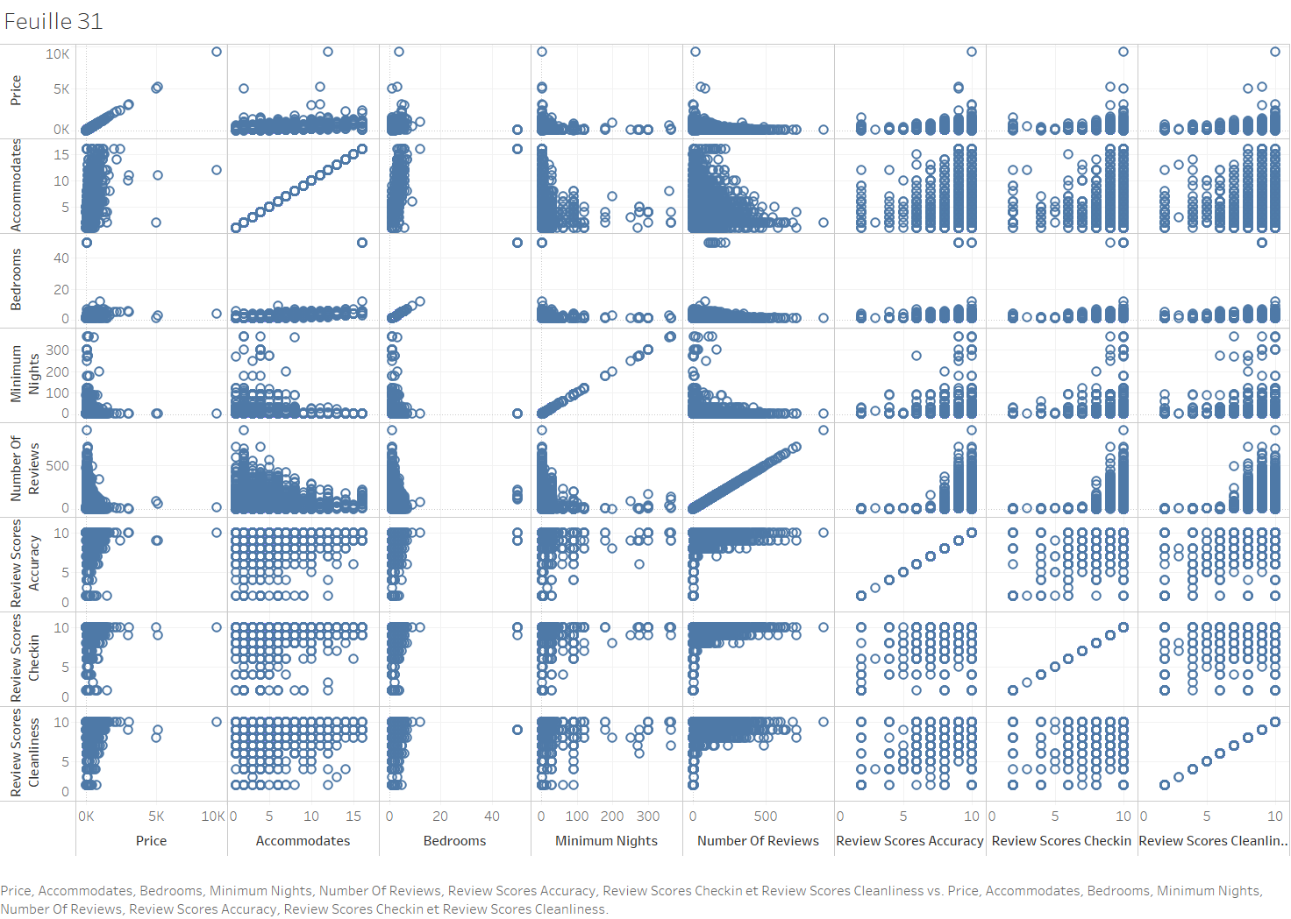

Slide 25
